Slide 1

Introduction to MACHINE LEARNING 2023-204
Fosca Giannotti + Roberto Pellungrini
Revisited slides from Lecture Notes for Chapter 7 “Introduction to Data Mining”, 2nd Edition by Tan, Steinbach, Karpatne, Kumar, with insertion from other recommended references-

Slide 2

CRoss-Industry Standard Process for Data Mining

Slide 3
Why Should There be a Standard Process?
The data mining process must be reliable and repeatable by people with little data mining background.
Framework for recording experience
Allows projects to be replicated
Aid to project planning and management
“Comfort factor” for new adopters
Demonstrates maturity of Data Mining
Reduces dependency on “stars”

Slide 4
CRISP-DM
Non-proprietary
Application/Industry neutral
Tool neutral
Focus on business issues
As well as technical analysis
Framework for guidance
Experience base
Templates for Analysis

Slide 5
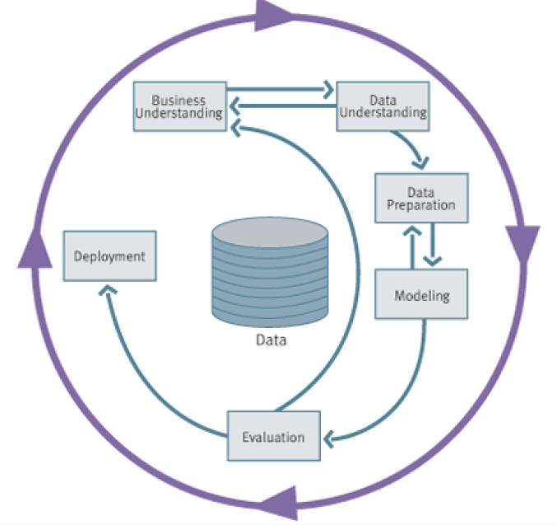
CRISP Model - Overview

Slide 6
Phases
Business Understanding
Project objectives and requirements understanding, Data mining problem definition
Data Understanding
Initial data collection and familiarization, Data quality problems identification
Data Preparation
Table, record and attribute selection, Data transformation and cleaning
Modeling
Modeling techniques selection and application, Parameters calibration
Evaluation
Business objectives & issues achievement evaluation
Deployment
Result model deployment, Repeatable data mining process implementation

Slide 7
Phases
Business Understanding
Project objectives and requirements understanding, Data mining problem definition
Data Understanding
Initial data collection and familiarization, Data quality problems identification
Data Preparation
Table, record and attribute selection, Data transformation and cleaning
Modeling
Modeling techniques selection and application, Parameters calibration
Evaluation
Business objectives & issues achievement evaluation
Deployment
Result model deployment, Repeatable data mining process implementation

Slide 8
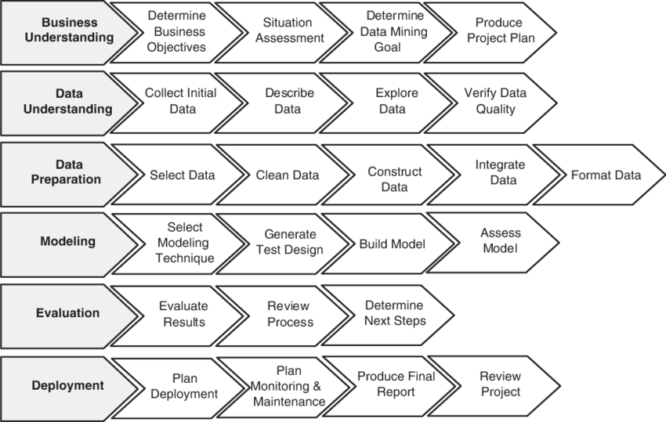
Phases and Tasks

Slide 9
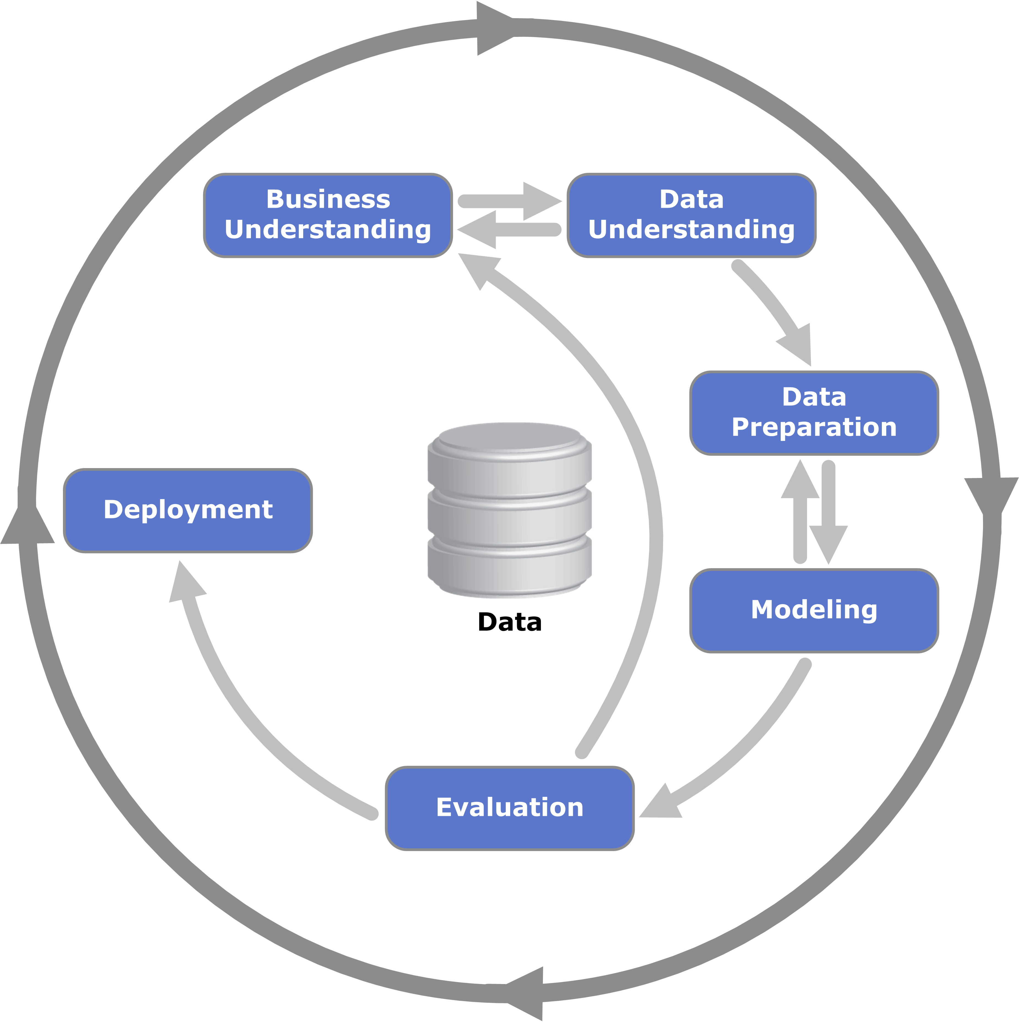
Business Understanding
Determine business objectives
thoroughly understand, from a business perspective, what the client really wants to accomplish
uncover important factors, at the beginning, that can influence the outcome of the project
neglecting this step is to expend a great deal of effort producing the right answers to the wrong questions
Assess situation
more detailed fact-finding about all of the resources, constraints, assumptions and other factors that should be considered
flesh out the details

Slide 10
Business Understanding
Determine data mining goals
a business goal states objectives in business terminology
a data mining goal states objectives in technical terms
A business goal: “Increase catalog sales to existing customers.”
A data mining goal: “Predict how many widgets a customer will buy, given their purchases over the past three years, demographic information (age, salary, city) and the price of the item.”
Produce project plan
describe the intended plan for achieving the data mining goals and the business goals
the plan should specify the anticipated set of steps to be performed during the rest of the project including an initial selection of tools and techniques

Slide 11
Data Understanding
Explore the Data
Verify the Quality
Find Outliers
Starts with an initial data collection and proceeds with activities in order to get familiar with the data, to identify data quality problems, to discover first insights into the data or to detect interesting subsets to form hypotheses for hidden information.

Slide 12
Data Understanding
Collect initial data
acquire within the project the data listed in the project resources
includes data loading if necessary for data understanding
possibly leads to initial data preparation steps
if acquiring multiple data sources, integration is an additional issue, either here or in the later data preparation phase
Describe data
examine the “gross” or “surface” properties of the acquired data
report on the results

Slide 13
Data Understanding
Explore data
tackles the data mining questions, which can be addressed using querying, visualization and reporting including:
distribution of key attributes, through aggregations
relations between pairs of attributes
properties of significant sub-populations
may address directly the data mining goals
may contribute to data description and quality reports
may feed into the transformation and other data preparation needed
Verify data quality
examine the quality of the data, addressing questions such as: “Is the data complete?”, Are there missing values in the data?”

Slide 14
Data Preparation
Takes usually over 90% of the time
Collection
Assessment
Consolidation and Cleaning
Data selection
Transformations
Covers all activities to construct the final dataset from the initial raw data. Data preparation tasks are likely to be performed multiple times and not in any prescribed order. Tasks include table, record and attribute selection as well as transformation and cleaning of data for modeling tools.

Slide 15
Data Preparation
Select data
decide on the data to be used for analysis
criteria include relevance to the data mining goals, quality and technical constraints such as limits on data volume or data types
covers selection of attributes as well as selection of records in a table
Clean data
raise the data quality to the level required by the selected analysis techniques
may involve selection of clean subsets of the data, the insertion of suitable defaults or more ambitious techniques such as the estimation of missing data by modeling

Slide 16
Data Preparation
Construct data
constructive data preparation operations such as the production of derived attributes, entire new records or transformed values for existing attributes
Integrate data
methods whereby information is combined from multiple tables or records to create new records or values
Format data
formatting transformations refer to primarily syntactic modifications made to the data that do not change its meaning, but might be required by the modeling tool

Slide 17
Modeling
Select the modeling technique
(based upon data mining objectives)
Build model
(Parameter settings)
Assess model
(rank the models)
Various modeling techniques are selected and applied and their parameters are calibrated to optimal values. Some techniques have specific requirements on the form of data. Therefore, stepping back to the data preparation phase is often necessary.

Slide 18
Modeling
Select modeling technique
select the actual modeling technique that is to be used ex) decision tree, neural network
if multiple techniques are applied, perform this task for each technique separately
Generate test design
before actually building a model, generate a procedure or mechanism to test the model’s quality and validity ex) In classification, it is common to use error rates as quality measures for data mining models. Therefore, typically separate the dataset into train and test set, build the model on the train set and estimate its quality on the separate test set

Slide 19
Modeling
Build model
run the modeling tool on the prepared dataset to create one or more models
Assess model
interprets the models according to his domain knowledge, the data mining success criteria and the desired test design
judges the success of the application of modeling and discovery techniques more technically
contacts business analysts and domain experts later in order to discuss the data mining results in the business context
only consider models whereas the evaluation phase also takes into account all other results that were produced in the course of the project

Slide 20
Evaluation
Evaluation of model
how well it performed on test data
Methods and criteria
depend on model type
Interpretation of model
importance and hardness depend on the algorithm
Thoroughly evaluate the model and review the steps executed to construct the model to be certain it properly achieves the business objectives. A key objective is to determine if there is some important business issue that has not been sufficiently considered. At the end of this phase, a decision on the use of the data mining results should be reached

Slide 21
Evaluation
Evaluate results
assesses the degree to which the model meets the business objectives
seeks to determine if there is some business reason why this model is deficient
test the model(s) on test applications in the real application if time and budget constraints permit
also assesses other data mining results generated
unveil additional challenges, information or hints for future directions

Slide 22
Evaluation
Review process
do a more thorough review of the data mining engagement in order to determine if there is any important factor or task that has somehow been overlooked
review the quality assurance issues ex) “Did we correctly build the model?”
Determine next steps
decides how to proceed at this stage
decides whether to finish the project and move on to deployment if appropriate or whether to initiate further iterations or set up new data mining projects
include analyses of remaining resources and budget that influences the decisions

Slide 23
Deployment
Determine how the results need to be utilized
Who needs to use them?
How often do they need to be used
Deploy Data Mining results
The knowledge gained will need to be organized and presented in a way that the customer can use it. However, depending on the requirements, the deployment phase can be as simple as generating a report or as complex as implementing a repeatable data mining process across the enterprise.

Slide 24
Deployment
Plan deployment
in order to deploy the data mining result(s) into the business, takes the evaluation results and concludes a strategy for deployment
document the procedure for later deployment
Plan monitoring and maintenance
important if the data mining results become part of the day-to-day business and it environment
helps to avoid unnecessarily long periods of incorrect usage of data mining results
needs a detailed on monitoring process
takes into account the specific type of deployment

Slide 25
Deployment
Produce final report
the project leader and his team write up a final report
may be only a summary of the project and its experiences
may be a final and comprehensive presentation of the data mining result(s)
Review project
assess what went right and what went wrong, what was done well and what needs to be improved

Slide 26
Summary
Why CRISP-DM?
The data mining process must be reliable and repeatable by people with little data mining skills
CRISP-DM provides a uniform framework for
guidelines
experience documentation
CRISP-DM is flexible to account for differences
Different business/agency problems
Different data

Slide 27
References
Pete Chapman (NCR), Julian Clinton (SPSS), Randy Kerber (NCR), Thomas Khabaza (SPSS), Thomas Reinartz, (DaimlerChrysler), Colin Shearer (SPSS) and Rüdiger Wirth (DaimlerChrysler) “CRISP-DM 1.0 -Step-by-step data mining guide”
Websites
http://www.crisp-dm.org/
http://www.spss.com/
http://www.kdnuggets.com/

